Slide 1

UltraCalc
A professional-grade desktop calculator built entirely in Python & Tkinter
9 Calculator Modes
Desktop Version
Python 1.14.3
Advance Calculations
CSV Export
Dark & Light Themes
Live Currency Rates
Tested on macOS
By: Srishti Sharma
One-Stop Scientific Calculator — Built with Python

Slide 2
9 Modes, One App
Each mode is a fully independent calculator — switch instantly from the sidebar
🔢 Basic
Standard arithmetic with live preview
∫ Scientific
36 functions, memory, 2nd mode
σ Statistics
Sum, mean, median, mode, std dev, variance, range & geo mean
♥ Health
BMI, BMR, Body Fat, Calories
₹ Finance
SI, CI, EMI, ROI, Discount, TVM
△ Trigonometry
Values, Find Side, Find Angle
</> Programming
HEX/BIN/OCT, bitwise ops, 32-bit
=X Eq Solver
Solve, differentiate, integrate, factor
⇄ Converter
12 categories + live currency rates
⚠ Currently tested and optimised for laptop & desktop only — mobile compatibility not yet verified

Slide 3
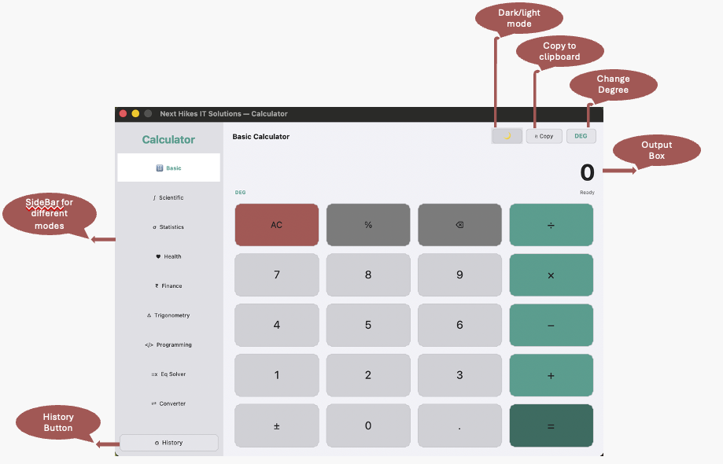
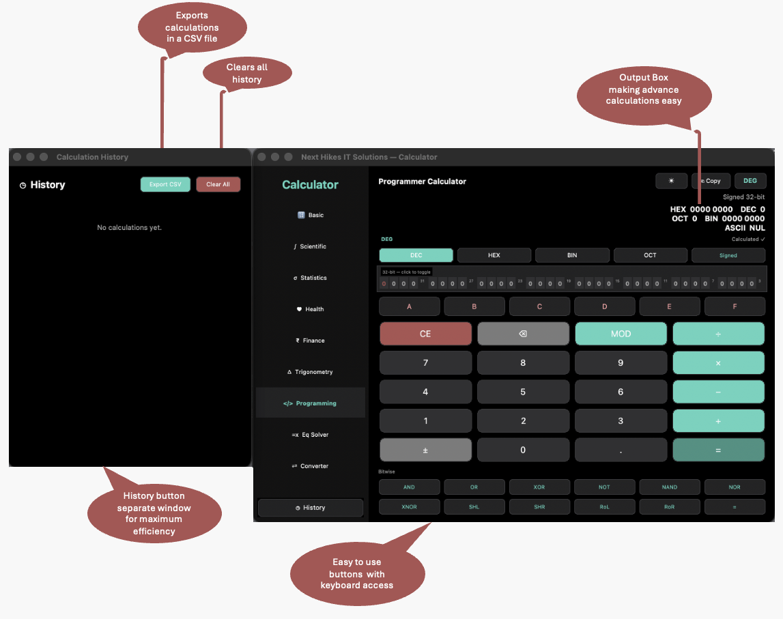
The Calculator
Clean UI · Sidebar navigation · Multiple modes
900x615x
Fixed window size
Dark + Light
Theme toggle
Keyboard
Full Key Binding
History
50 entries + CSV
⚠ Currently tested and optimised for laptop & desktop only — mobile compatibility not yet verified

Slide 4
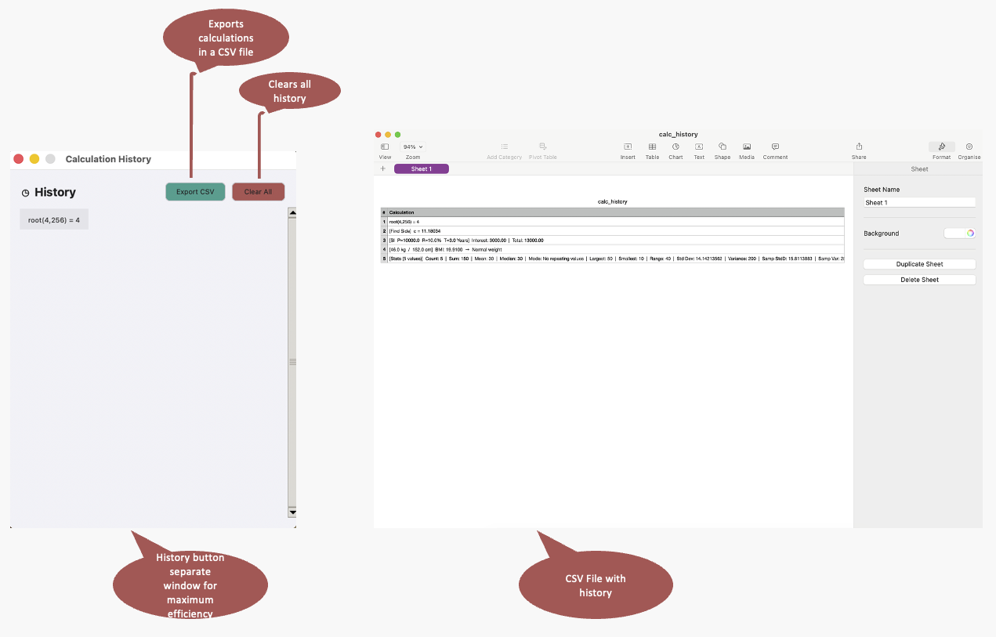
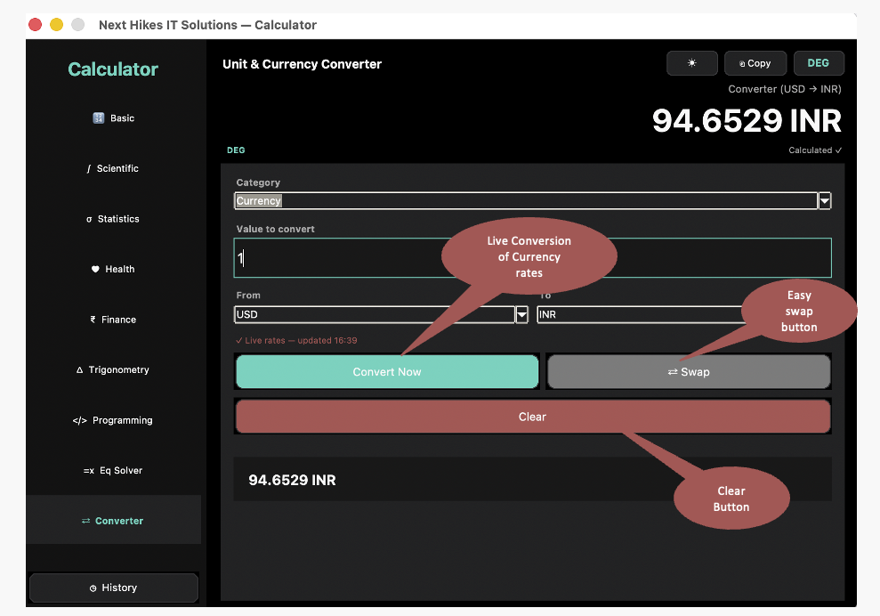
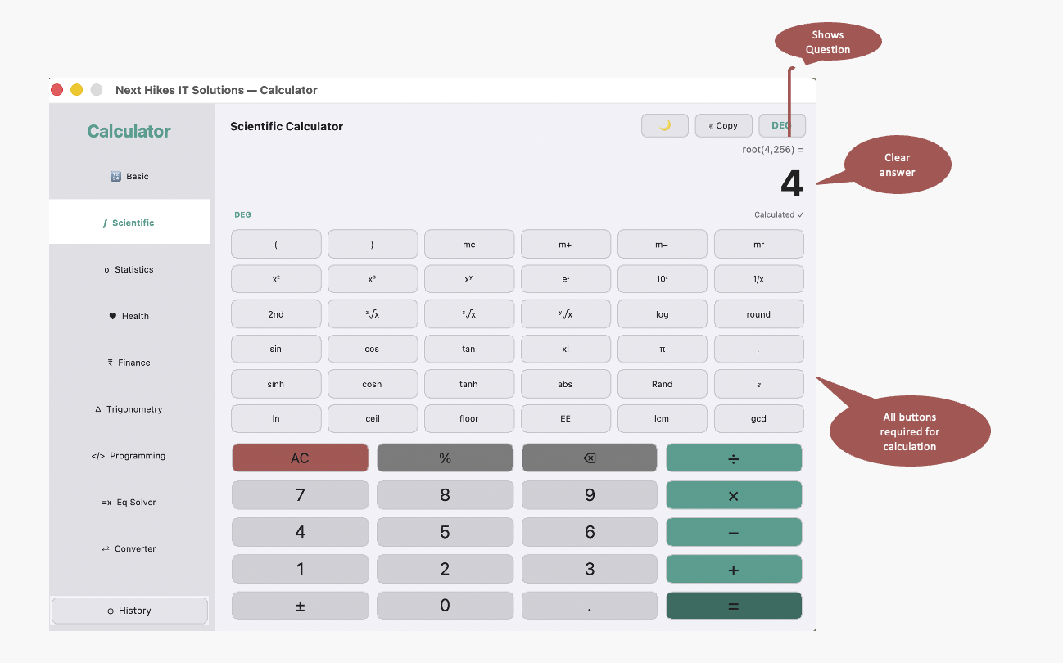
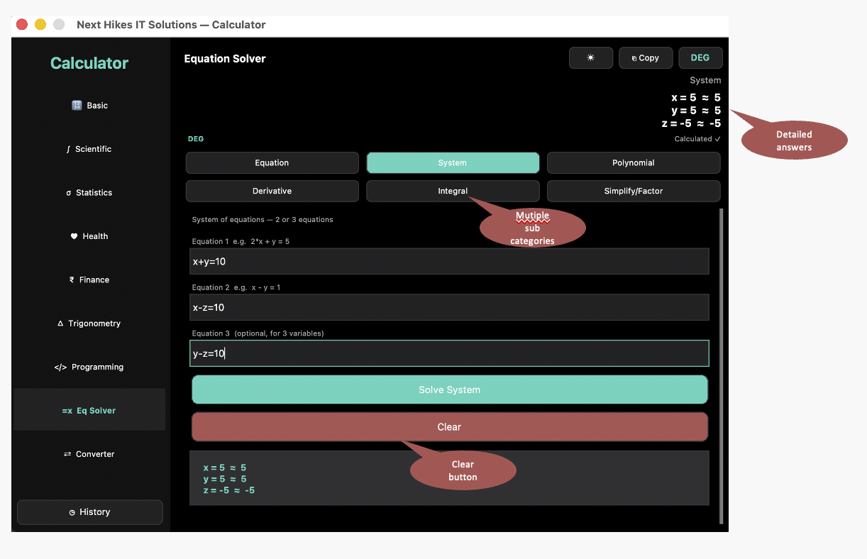
The Calculator
⚠ Currently tested and optimised for laptop & desktop only — mobile compatibility not yet verified

Slide 5
Libraries & Tools Used
Why each library was chosen — not just what it is
Tkinter
Built-in Python GUI library. No install needed. Cross-platform window and widget system.
ast + SafeEval
Safely parses math expressions into a syntax tree — prevents code injection instead of using raw eval().
math
All scientific functions: sin, cos, log, sqrt, factorial, hyperbolic, ceiling, floor.
statistics
Mean, median, mode, variance, standard deviation — avoids reimplementing stat formulas.
json
Saves and loads calculation history to a local file so history persists between sessions.
csv
Exports history to a spreadsheet-compatible format in one click.
re
Preprocesses expressions: converts × → *, detects 5! → factorial(5), handles % notation.
urllib
Fetches live currency exchange rates from ExchangeRate API (with offline fallback).
numpy
Optional: finds roots of polynomials of any degree. Falls back to built-in for quadratics.
sympy
Optional: symbolic algebra — solves equations, derivatives, integrals, factoring.
⚠ Currently tested and optimised for laptop & desktop only — mobile compatibility not yet verified

Slide 6
Challenges & How They Were Solved
Real problems encountered during development
Finding the right libraries
Researched alternatives to raw eval() — discovered ast.NodeVisitor as the safe, correct approach for parsing math expressions.
Polished, aesthetic UI in Tkinter
Built a custom ProButton class from scratch using Canvas, drawing rounded rectangles and handling hover/click effects manually.
Issue
Issue
Fix
Fix
Managing 9 different calculator modes
Designed a shared app state pattern — each mode gets isolated StringVars for inputs, never touching the shared display.
Keyboard + mouse working together
Implemented focus detection (_focused_is_entry) so keyboard presses route correctly — to the active Entry field or to the calculator buttons.
Issue
Issue
Fix
Fix
Output concatenation bug
Traced bug to shared StringVars being written by multiple modules. Fixed by isolating all non-basic mode results to local variables.
Theme switching across all widgets
Implemented T as a mutable dict (not imported constants) so all widgets read live theme values at paint time rather than at creation time.
Issue
Issue
Fix
Fix
⚠ Currently tested and optimised for laptop & desktop only — mobile compatibility not yet verified

Slide 7
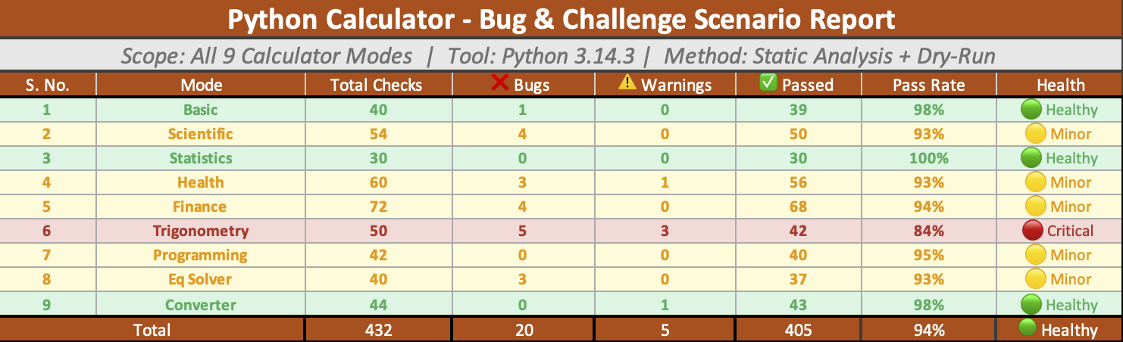
Edge Cases & Error Handling
Tested on macOS · Python 3.13 · Results verified manually
⚠ Currently tested and optimised for laptop & desktop only — mobile compatibility not yet verified

Slide 8
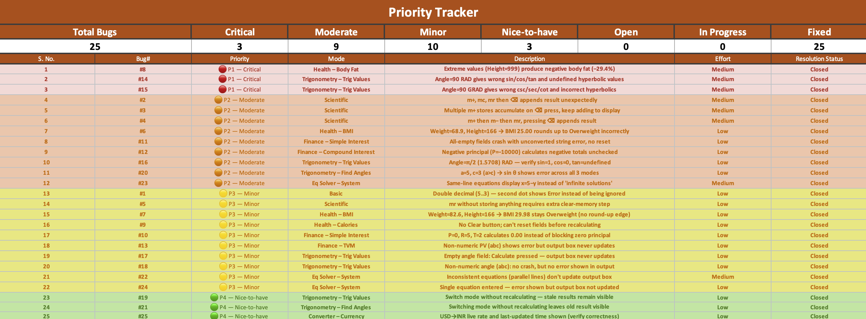
Edge Cases & Error Handling
Tested on macOS · Python 3.13 · Results verified manually
⚠ Currently tested and optimised for laptop & desktop only — mobile compatibility not yet verified

Slide 9
Why UltraCalc?
What makes it different from existing calculators
🖥️ Desktop App
Runs natively on Mac via Python 3.13. No browser, no internet required.
🌐 Fully Offline
No internet needed, runs completely offline with no external dependencies.
🌗 Dual Theme
Switches instantly between a sleek dark and clean light mode.
👨‍💻 Programmer Mode
Supports 32-bit operations for binary, octal, and hex calculations.
⌨️ Keyboard + Mouse
Full keyboard shortcuts alongside clickable rounded buttons.
🧮 SymPy-Powered
Solves real equations using symbolic math, not just approximations.
🔢 9 Modes in One
Basic · Scientific · Stats · Health · Finance · Trig · Programming · Equations · Converter
📐 Trig, Health & Stats
All advanced calculator modes packed into a single window.
📤 Export History
All calculations exportable to CSV with one click.
🚫 Ad-Free & Private
No ads, no subscriptions, no tracking of any kind.
⚠ Currently tested and optimised for laptop & desktop only — mobile compatibility not yet verified

Slide 10
References
Language & Runtime
— Python 3 Official Docs — docs.python.org
— Python ast module — docs.python.org/3/library/ast.html
UI Framework
— Tkinter Reference — docs.python.org/3/library/tkinter.html
— TkDocs Tutorial — tkdocs.com
Symbolic Math
— SymPy Documentation — docs.sympy.org
— SymPy Parser & Transformations — sympy.org/en/index.html
Finance Formulas
— EMI Formula — RBI guidelines reference
— TVM (Time Value of Money) — Investopedia.com
Health Formulas
— US Navy Body Fat Method — NASM reference
— Mifflin-St Jeor BMR Equation — pubmed.ncbi.nlm.nih.gov
Currency API
— ExchangeRate-API — exchangerate-api.com
— Free tier used: v6.exchangerate-api.com/v6/{key}/latest/USD
⚠ Currently tested and optimised for laptop & desktop only — mobile compatibility not yet verified

Slide 11
Thank You!

